Slide 1

CMR COLLEGE OF ENGINEERING & TECHNOLOGY
Kandlakoya, Medchal, Hyderabad - 501401
Department of Computer Science and Engineering
Diabetes Disease Prediction Using Machine
Learning Algorithms
G.Harshitha - 19H51A0509
G.Vinay - 19H51A05D4
J.Vishnukanth - 20H55A0511
Under esteemed guidance of
Mr.B.Sivaiah( Associate Professor )

Slide 2


CONTENTS:
Abstract
Introduction
Existing models
Implementation
Proposed Solution
Data Collection
Performace Metrics
Conclusion
References

Slide 3
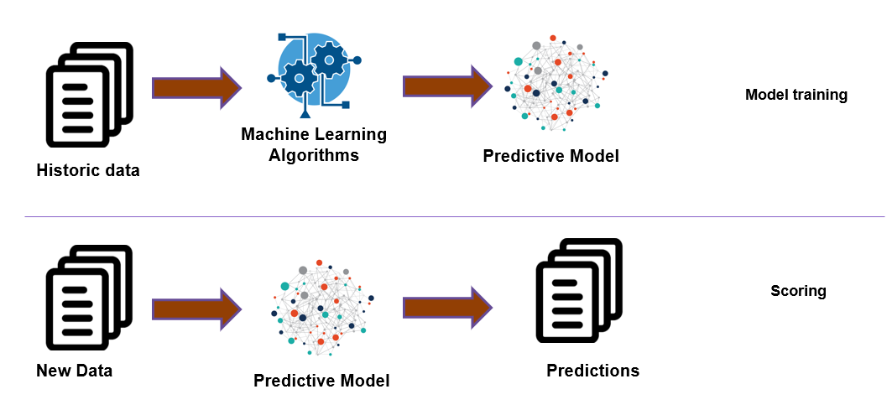

ABSTRACT
Aim:To develop a machine learning model that can predict diabetes disease.
Machine Learning is a technology that helps computer to learn and act accordingly.
It helps the computer to learn the complex model and predict the data.
The value of machine learning is recognized well in health care industry which has large pool of data.
The proposed project is based on a typical machine learning algorithm.

Slide 4
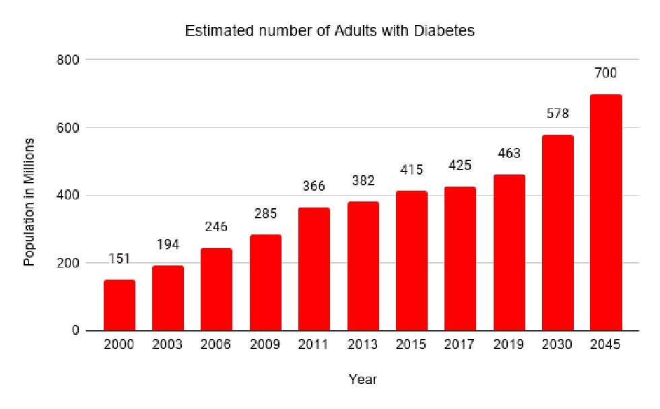
INTRODUCTION
The most notorious diseases now-a-days is Diabetes.
Diabetes is increasing day by day in the world because of environmental, genetic factors.
Diabetes is a hormonal disorder in which the inability of the body to produce insulin causes the metabolism of sugar in the body to be abnormal, thereby, raising the blood glucose levels in the body of a particular individual.
Intense hunger, thirst and frequent urination are some of the observable characteristics.
Fig. 1. Number of diabetic patients estimated with respect to year
In the year 2019, approx.463 million adults between the age of 20-79 years had diabetes(International Diabetes Federation-IDF).
79% of the adult population were living in the countries with the low and middle-income groups. It is estimated that by the year 2045 approx. 700 million people will have diabetes (IDF).

Slide 5
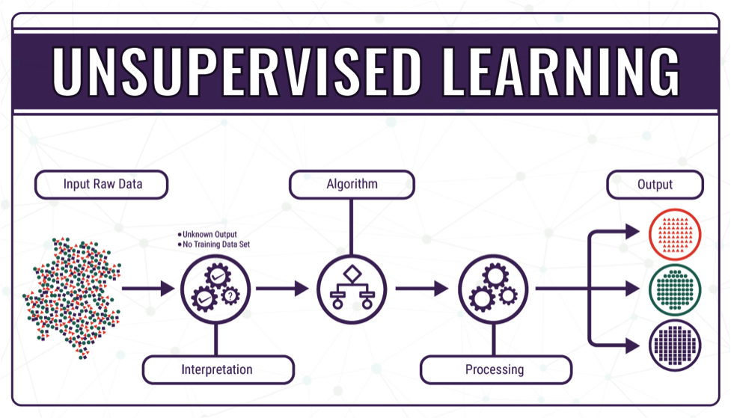
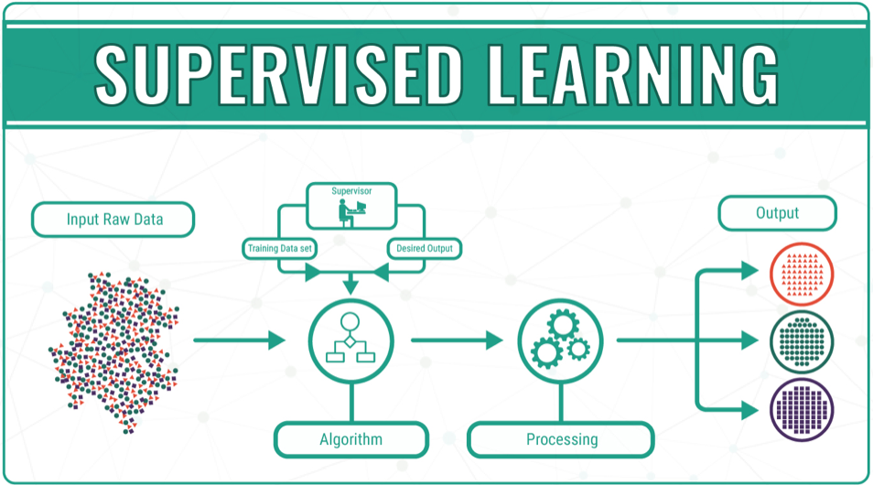
Machine Learning algorithms:
Unsupervised Learning
Supervised Learning

Slide 6

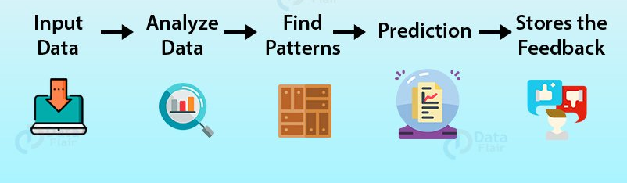
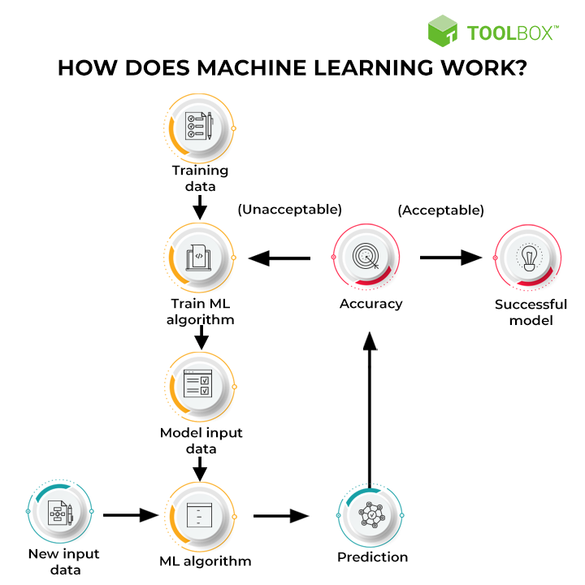
Existing models
WEKA Tool:
WEKA(Waikato Environment for Knowledge Analysis) an open source data mining tool is used for the analysis of diabetes database.
Uses algorithms like Naive Bayes, Support Vector Machine, Random Forest, and Simple CART.
Authors did the 70:30 train and test split for applying different machine algorithms.
HbA1C Test:
The most common tests to make sure diabetes disease are the HbA1C(Glycosylated Hemoglobin) test.
These tests take approximately one-two days to know the result and test results differ according to the patient having blood disorder, iron-deficiency anemia, uncommon hemoglobin, kidney and liver diseases.
HbA1c testing helps predict the likelihood that patients will develop diabetes in the future.
Patients with normal HbA1c have a low incidence of diabetes and may not require rescreening in 3 years.

Slide 7
Implementation
Weka tool:
Weka is a collection of machine learning algorithms for data mining tasks. It contains tools for data preparation, classification, regression, clustering, association rules mining, and visualization.
Data Collection & Preparation
Data Collection & Prepocesing:
The training dataset used for data mining is the Pima Indians Diabetes Database from UCI Machine Learning Repository.
Some of these cases contain unreal value for example “age is 0, BMI is 0”. Such unreal records have been removed from the dataset.
Model Building:
Building an ML Model requires splitting of data into two sets, such as 'training set' and 'testing set' in the ratio of 80:20 or 70:30.
Evaluation & Deployment:
The accuracy of a classifier on a given test set is the percentage of test set tuples that are correctly classified by the classifier.
Model Building Mining Technologies
Evaluation & Deployment

Slide 8
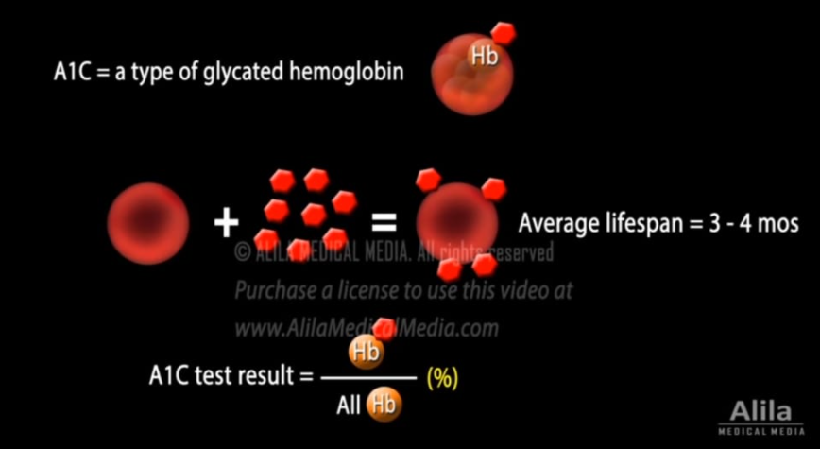
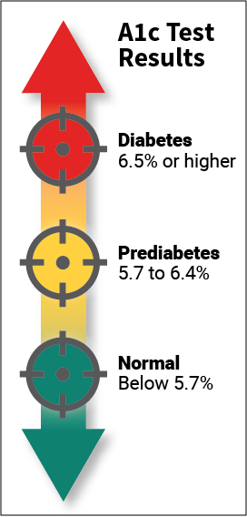
HbA1C Test:

Slide 9
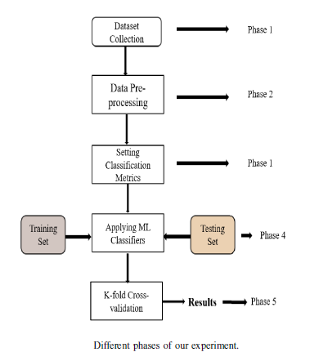
PROposed solution
The proposed solution is we are implementing an application where it will be helpful to predict diabetes disease in early stage.
To find the most optimal results in terms of accuracy and computational time for Diabetes disease prediction using machine learning.
It focus on prediction of diabetes using health records of the diabetic patients.
By using machine learning techniques, knowledge is acquired through these records, containing numerical values, to predict whether the patient is having diabetes or not.

Slide 10
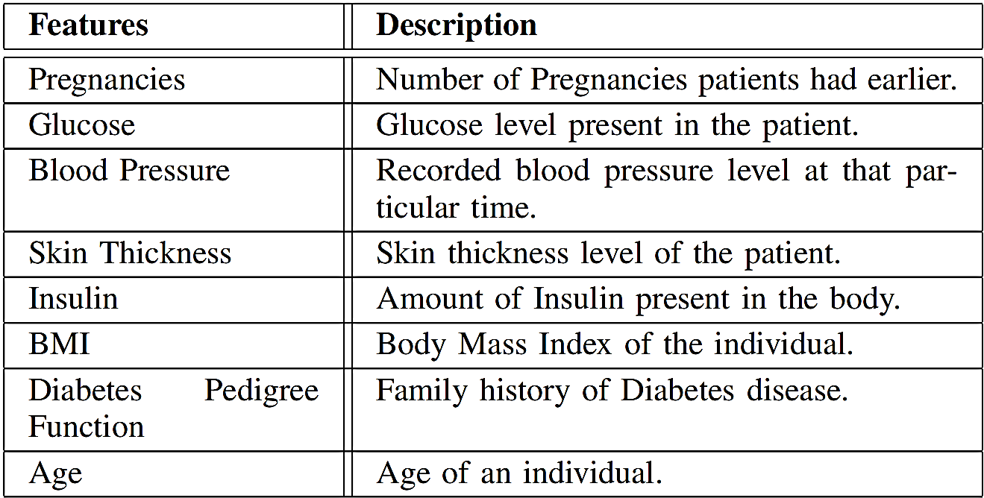
Data collection

Slide 11
Performance metrics

Slide 12
CONCLUSION
We have described a machine learning approach to predict diabetes as in early stage diabetes.
Study shows that it's possible for some people to reverse it. Through diet changes and weight loss, you may be able to reach and hold normal blood sugar levels without medication.
Hence it becomes almost mandatory to use machine learning to predict diabetes disease.
Predicted diabetes by using new Machine Learning Algorithms and find out the initial symptoms of diabetes.
The approach is going to compare with different algorithms. The result of our method shows better performance in terms of efficiency and accuracy.

Slide 13
References
[1] P. Saeedi, I. Petersohn, P. Salpea, B. Malanda, S. Karuranga, N. Unwin, S. Colagiuri, L. Guariguata, A. A. Motala, K. Ogurtsova, J. E. Shaw, D. Bright, and R. Williams, “Global and regional diabetes prevalence estimates for 2019 and projections for 2030 and 2045: Results from the international diabetes federation diabetes atlas, 9th edition,” Diabetes Research and Clinical Practice, vol. 157, p.107843, 2019.
[2] A. Mir and S. N. Dhage, “Diabetes disease prediction using machine learning on big data of healthcare,” in 2018 Fourth International Conference on Computing Communication Control and Automation (ICCUBEA), 2018, pp. 1–6.
[3] D. Sisodia and D. S. Sisodia, “Prediction of diabetes using classification algorithms,” Procedia Computer Science, vol.
132, pp. 1578 – 1585, 2018, international Conference on Computational Intelligence and Data Science. [Online]. Available: http://www.sciencedirect.com/science/article/pii/S1877050918308548
[4] J. Smith, J. Everhart, W. Dickson, W. Knowler, and R. Johannes, “Using the adap learning algorithm to forcast the onset of diabetes mellitus,” Proceedings - Annual Symposium on Computer Applica_x0002_tions in Medical Care, vol. 10, 11 1988.

Slide 14

THANK YOU

